Slide 1

Exam Proctoring Using Biometrics
Achanta Ramya Sri CB.EN.U4CSE18302
Chandravadhana. A CB.EN.U4CSE18310
Dhivakar K CB.EN.U4CSE18314
Sandhya CB.EN.U4CSE18328
Akhila Kolli CB.EN.U4CSE18333

Slide 2
Abstract
The ongoing pandemic has forced the education sector to plan continuity in learning and exams. Therefore, it is necessary to proctor and monitor the students.
The project aims to use face and eye movement to ensure protection from malpractices.
The monitoring system detects if the student moves the face away from the screen or sees anywhere other than the screen.
Traits Used: Keystroke dynamics, Face and Eye movement.

Slide 3
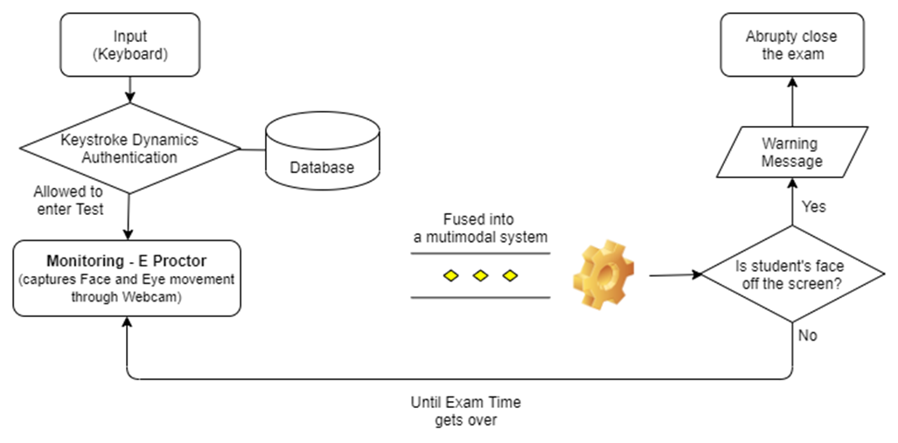
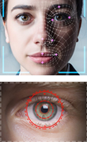
Block Diagram of Workflow

Slide 4

Keystroke Dynamics

Slide 5
Definition and Working
Keystroke dynamics refers to the automated method of identifying or confirming the identity of an individual based on the manner and the rhythm of typing on a keyboard. Keystroke dynamics is a behavioral biometric.
How it works :
The rhythm with which some sequences of characters are typed can be very person dependent.
The features used for keystroke dynamics are:
⦁ Press-press duration (PPD)
⦁ Hold duration (HD)
⦁ Release-press duration (RPD)

Slide 6
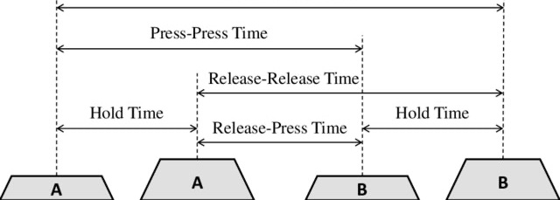
Definition and Working
The image shows the duration calculations for pressing 2 keys -A and B. Here, the smaller keys represent the key press event and the larger ones represent the key release event.

Slide 7
Dataset
Link: https://drive.google.com/drive/folders/1LxTWXm9SQZS2Mm1nC8D_ODfJc_G4iaYl?usp=sharing
⦁ This dataset captures typing attempts of 110 users.
⦁ Each user has attempted 8 times to type the string ‘united states’ and the corresponding timestamps of key press and release relative to the first key press have been captured.
⦁ Number of rows in training dataset: 880 ( data of 110 users )
⦁ No. of rows in test dataset: 220

Slide 8
Data Preprocessing
No missing values
No negative values
Feature generation is done (data can’t be used directly) :
Press-press, hold, release-press durations from this dataset.
⦁ PRESS – PRESS DURATION : Time between 2 continues presses.
⦁ RELEASE PRESS DURATION: Time between a release of 1 key and press of other.
⦁ HOLD DURATION: Time between a press and release of a key.

Slide 9
Exploratory Data Analysis (EDA)
Considering the first 5 of the 110 users i.e. 5x8 = 40 typing patterns.
Swarm plot: Swarm plots depict all the data points. Swarm plots attempt to avoid obscuring points by calculating non-overlapping positions instead of adding random jitter.
Using seaborn’s swarm plot function, we can generate swarm plots of release-press, press-press, and hold duration for these 5 users.

Slide 10
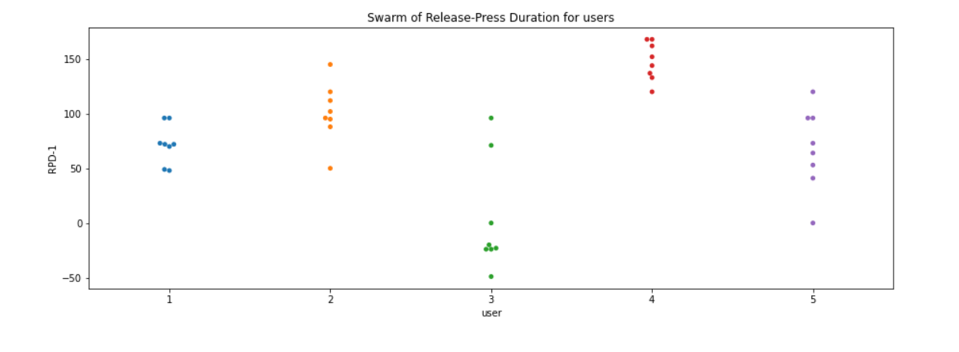
Swarm plot of Release-Press Duration
Analysing only two keys/letters ‘u’ and ‘n’.
So duration between two key presses for 8 times each user taken for analysis. Therefore 8 data points for every user plotted on graph.

Slide 11
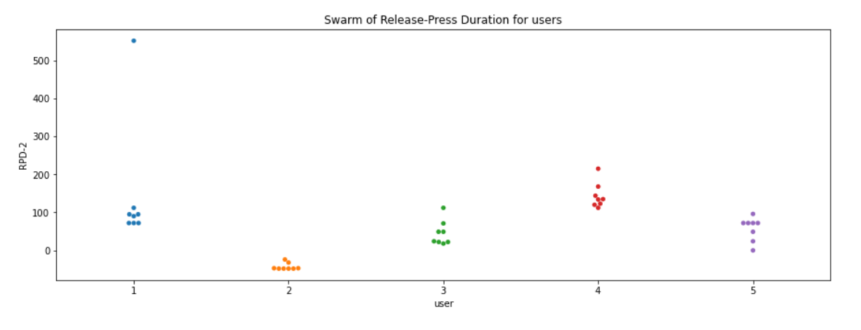
Swarm plot of Release-Press Duration
Similarly, the second graph two keys/letters were analysed ‘n’ and ‘i”.
From the above two graphs, not much can be inferred because it doesn’t give a solid typing pattern.Therefore, all 13 keys/letters were analysed ‘United States” i.e 13 X 8

Slide 12
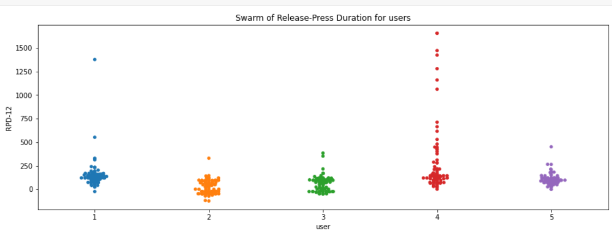
Swarm plot of Release-Press Duration
We can see RPD for some users is different but for some is similar so RDP cannot solely identify the user.

Slide 13
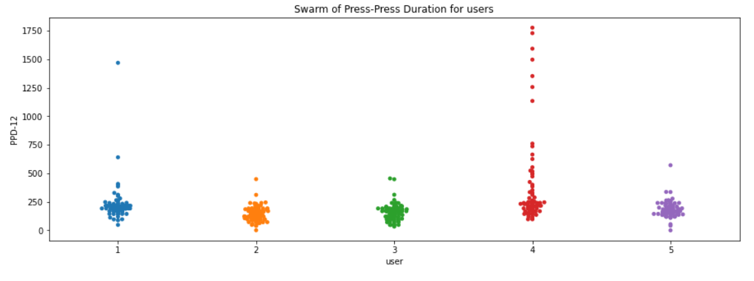
Swarm plot of Press-Press Duration
Similarly, We can see PPD for some users is different but for some is similar so PPD cannot solely identify the user.

Slide 14
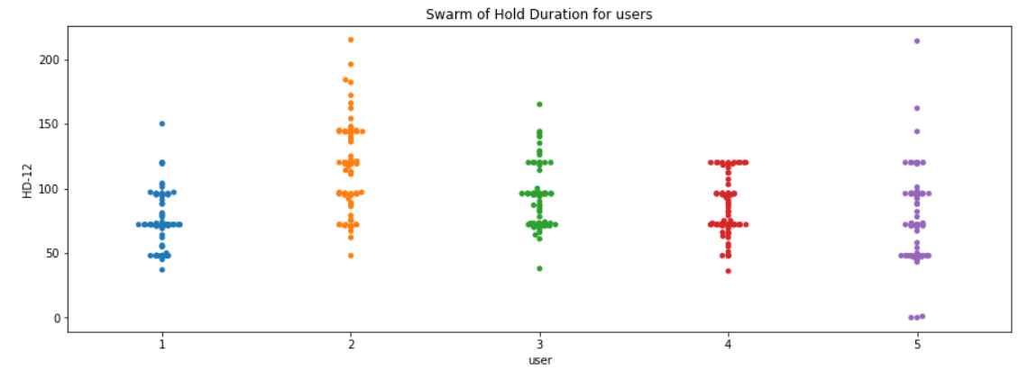
Swarm plot of Hold Duration
Now, Hold duration shows a different analysis. We can see that people tend to differ in their hold duration which means people take different time duration to press a particular key.

Slide 15
Inference from Swarm Plot
⦁ Hold duration is roughly different for each user which is correct since each user has a different typing speed according to his/her familiarity with typing.
⦁ Therefore, using histograms to check if any variations could be identified.
⦁ Since, each typing pattern consists of 13 keystrokes, scatter plots and line plots can be used.

Slide 16
Converting row features to column features for plotting
Now, each row in the dataset is a typing pattern corresponding to a user, but if we want to analyse the typing patterns across users(timestamps connected by lines), therefore we need to bring these row features into a single column.
For a particular user, there are 12 X 8 times (=96), the typing analysis is done. Therefore, for 5 users: 96 X 5 times (=480). Hence, the shape is 480 X 3.
Now, let’s try plotting the press press durations v/s press timestamps using points and lines (Scatter plot and Line plot respectively).

Slide 17
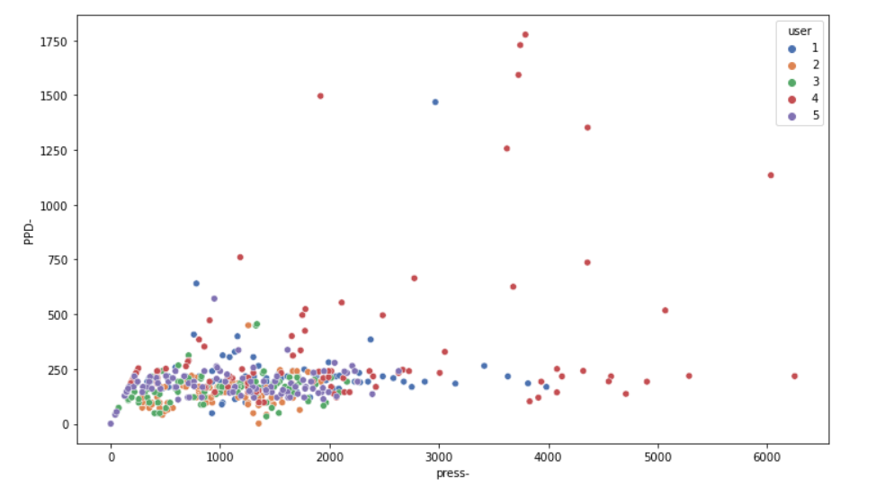
Scatter plot : PPD vs Press

Slide 18
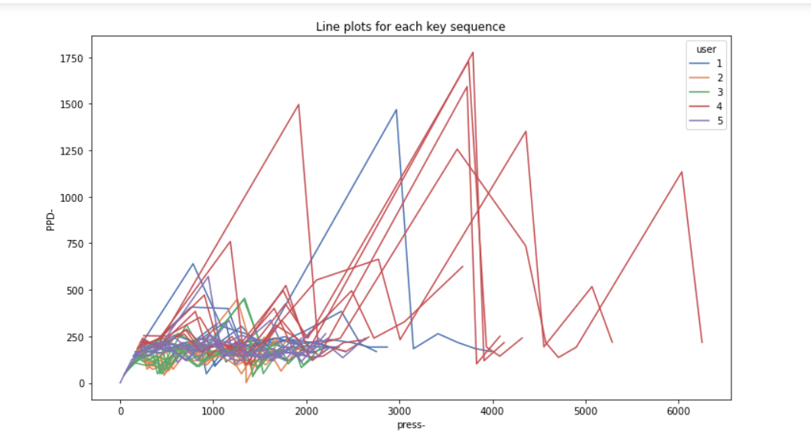
Line plot : PPD vs Press

Slide 19
Inference from Line plot : RDP vs Press
Note, here there are 40 line plots i.e. 8 line plots per user and 5 users are being considered.
Notice the jagged lines for user 4 (red lines).
The PPD suddenly increases and then becomes very low for the next key.
This means that this user waits for a relatively longer time before typing in 2 keys back to back.
So, we could say this user typically types in groups of 2 keys.
Now, imagine the level of security if we use sophisticated algorithms to generate insights and devise authentication techniques.
This would be something that the user wouldn’t even need to remember.

Slide 20
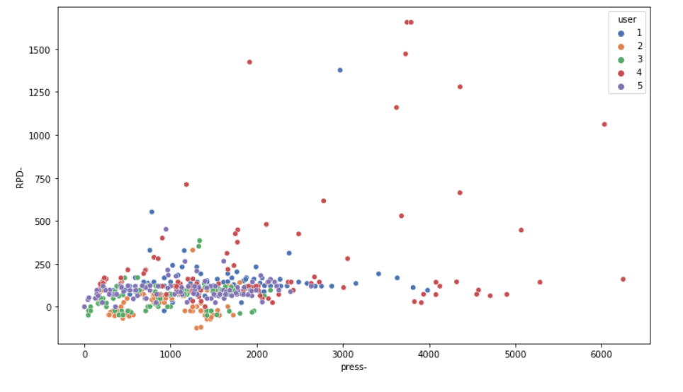
Scatter plot : RPD vs Press

Slide 21
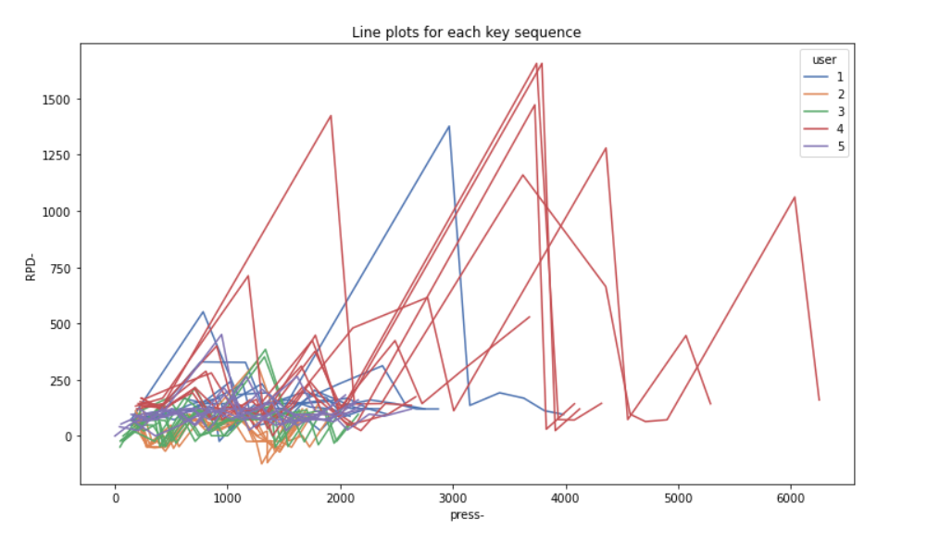
Line plot : RPD vs Press

Slide 22
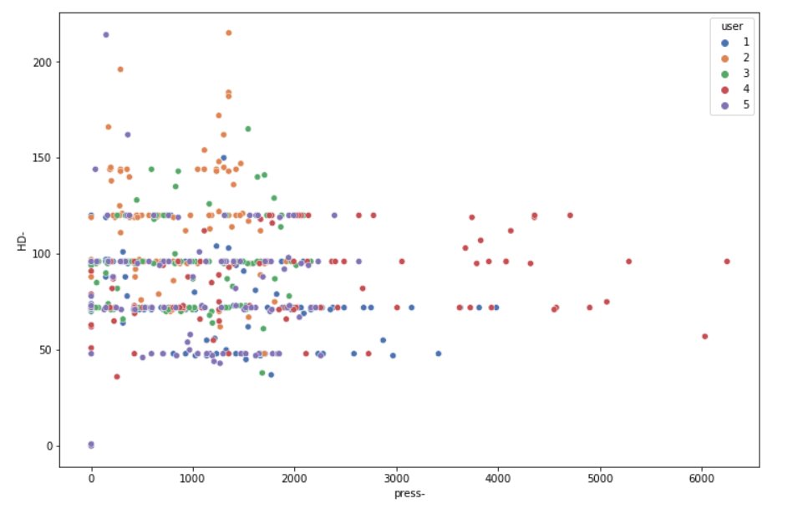
Scatter plot : HD vs Press

Slide 23
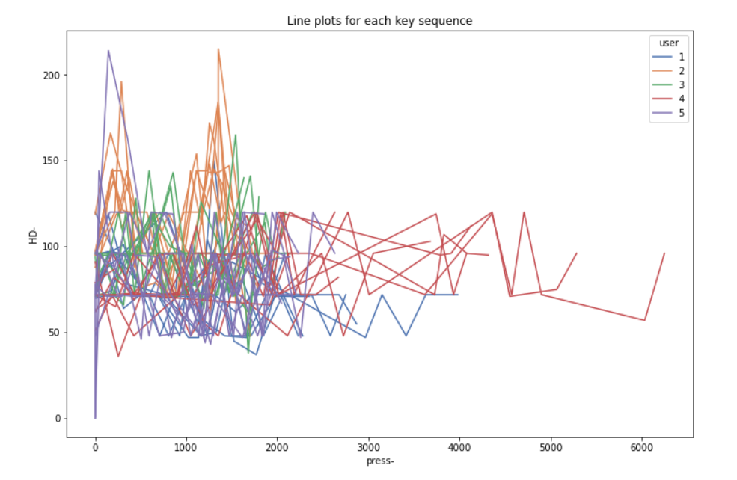
Line plot : HD vs Press
Hold duration for each key does not have any common pattern.

Slide 24
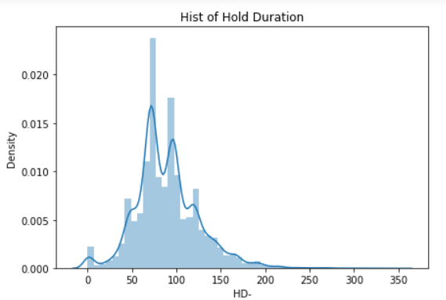
Visualizing transformed data using Histogram
Instead of directly using durations as inputs, we could group these durations into histograms which would represent groups of different typing speeds.
Density vs HD

Slide 25
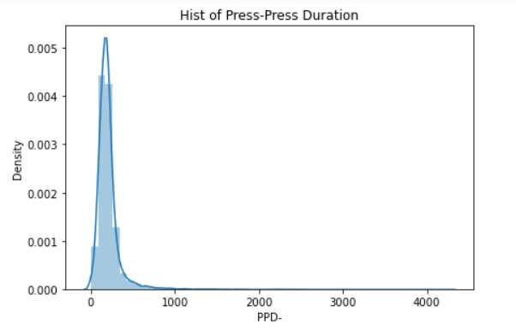
Visualizing transformed data using Histogram
Density vs PPD

Slide 26
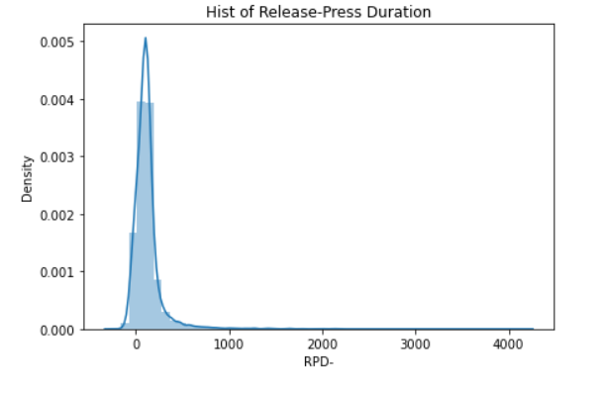
Visualizing transformed data using Histogram
Density vs RPD

Slide 27
Inference from Histogram
Here, we can see that we can easily classify the people in the higher bucket of values and lower buckets of values.
The people in the Higher bucket of values take
longer time to type -> Slow typers
The people in the Lower buckets of values take
shorter time to type -> Fast typers
Rather than us distinguishing slow typers and fast typers by looking the distribution, we can instead classify them into a range of levels. For example, we can divide the above distribution into 10 slots ranging from 0-9, meaning that a person with 0 is the fastest typer of the lot, 5 is typer of an average person and 9 is the slowest typer of the lot.
This process is termed as Binning

Slide 28
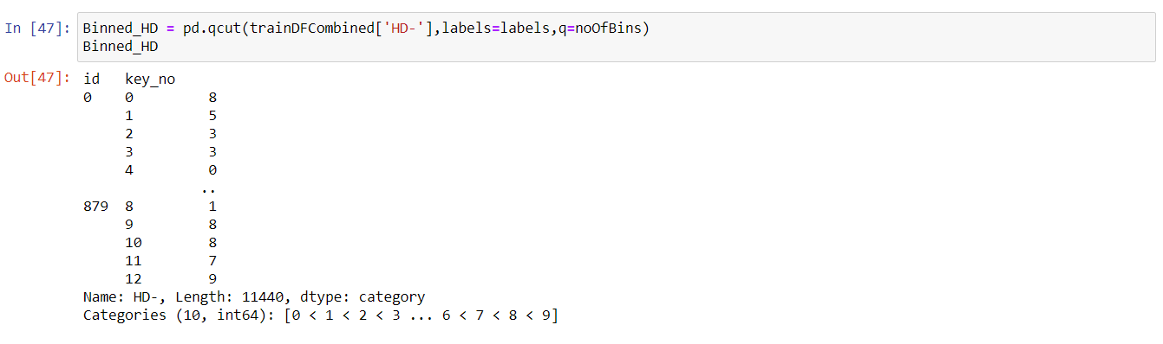
Binning
⦁ There is a special function called 'qcut' in pandas library that performs binning into 'q' cuts. In this function we specify the column name over which we want to perform the binning/bucketing. This function checks the distribution of values in the specified column and divides the distribution into equal frequencies with q number of bins.
⦁ We can see the categories it has grouped. Categories (10): [0 < 1 < 2 < 3 ... 6 < 7 < 8 < 9]

Slide 29
Binning
⦁ We encode the values to labels 0–9 in HD_Bin, PPD_Bin, RPD_Bin corresponding to the bins.
pd.qcut(df,retbins=True,labels=labels,bins=n)
⦁ We are setting retbins to True so that we can later use these bins over our test dataset.
⦁ For test datasets, since we already have these bins with us, we need not perform qcut. Instead we'll use cut which directly assigns the values into the appropriate bin.
⦁ We are encoding the values to labels 0–9 in HD_Bin, PPD_Bin, RPD_Bin corresponding to the bins.

Slide 30
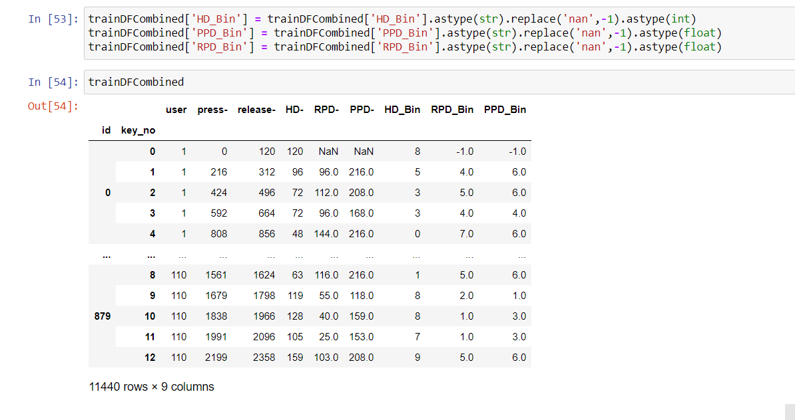
Binning
⦁ Since, there are 12 RPD, 12 PPD, 13 HD values corresponding to the 13 keystrokes in a typing pattern, we fill the missing RPD, PPD values by -1

Slide 31
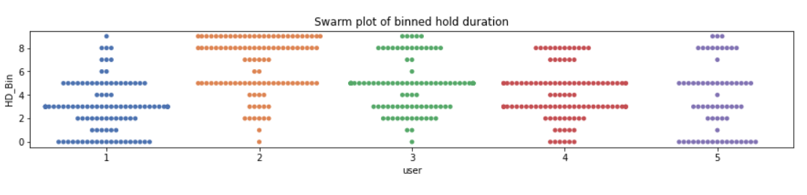
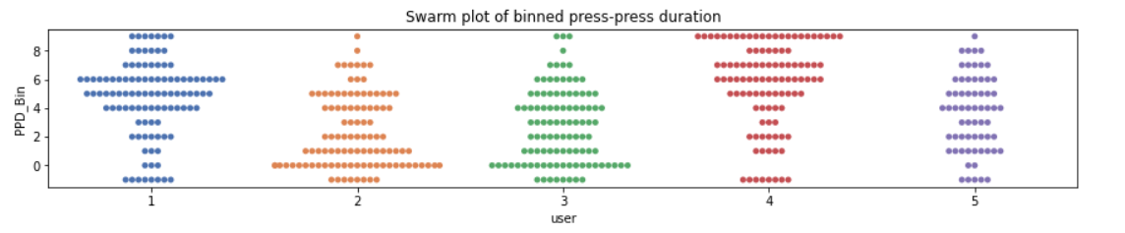
Swarm plot of binned data
Now we need to group data of Test dataset into buckets

Slide 32
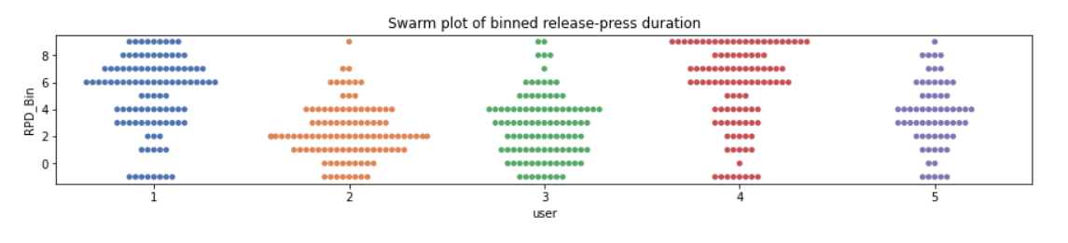
Swarm plot of binned data
Inference:
This indicates the Average Speed of every user.
For example, we can see from the RPD, PPD durations in the swarm plots.
For instance, User 4 has many encodings in the higher range of bins (more HD, PPD, RPD).
At the same time, User 2 has more encodings in the lower range of bins.
This implies that User 4 types relatively slowly than User 2.

Slide 33
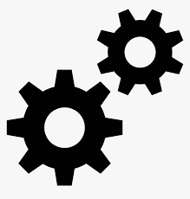
Train the dataset
Previously, in order to determine the bucket value, we had converted the typing patterns (row-wise) into grouped columns.
But in order to use machine learning techniques like KNN, we need to convert these properties/features back into rows. This could help us to identify the closest key dynamics signature for a user.

Slide 34
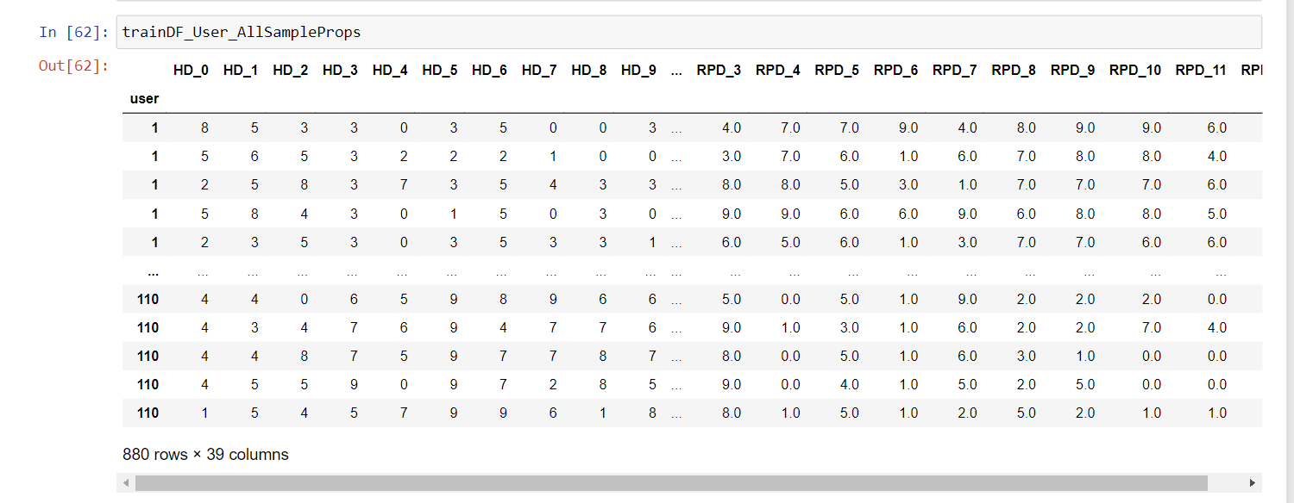
Train data

Slide 35
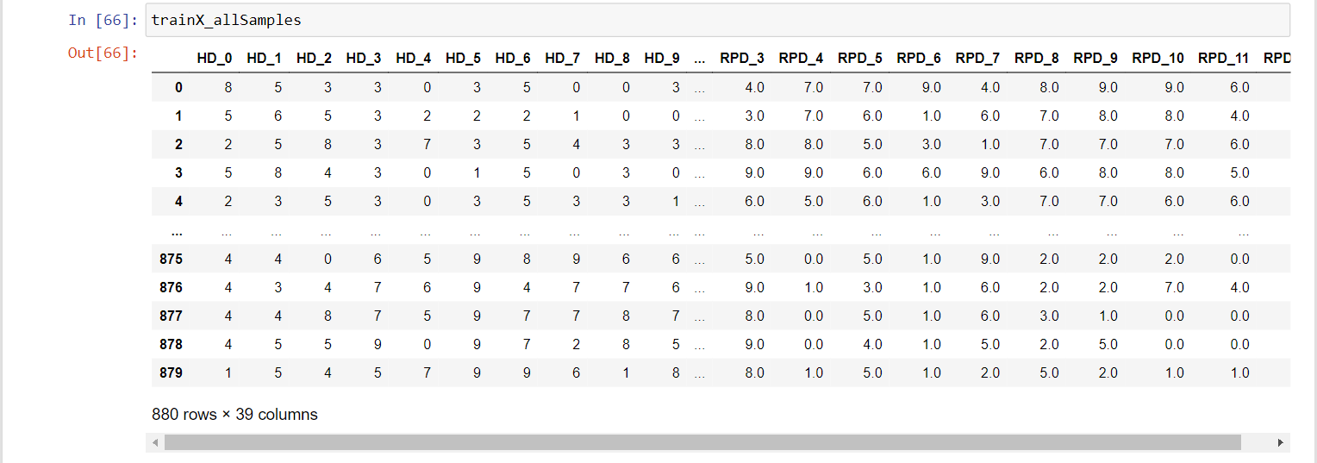
Train data

Slide 36
Validation data
⦁ Our test dataset has only the timestamps without the user id. So, in order to validate our models, we need to keep some validation dataset aside from the training dataset.
⦁ We have 110 users but only 8 samples per user, so we need to ensure that enough samples per user are present in training set.
⦁ Therefore, during test time, at least few samples must be present for each test user. For this, StratifiedShuffleSplit is performed.
⦁ StratifiedShuffleSplit: Provides train/test indices to split data in train/test sets. This cross-validation object is a merge of StratifiedKFold and ShuffleSplit, which returns stratified randomized folds. The folds are made by preserving the percentage of samples for each class.

Slide 37
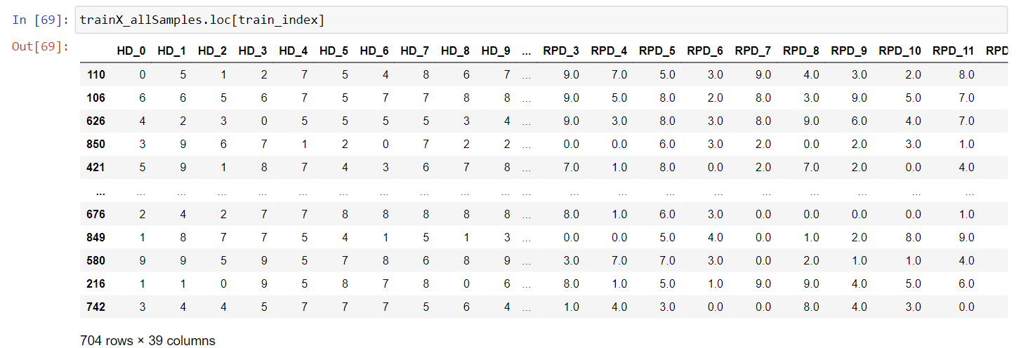
Validation data

Slide 38
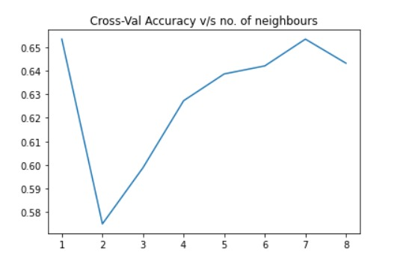
KNN (K Nearest Neighbour) Classifier
Now , we perform KNN classification for different ‘k’ values.
Graph : Cross-Validation Accuracy vs k value
Inference: The accuracy of the model is comparatively high when k=7
Accuracy=65.3409 %

Slide 39
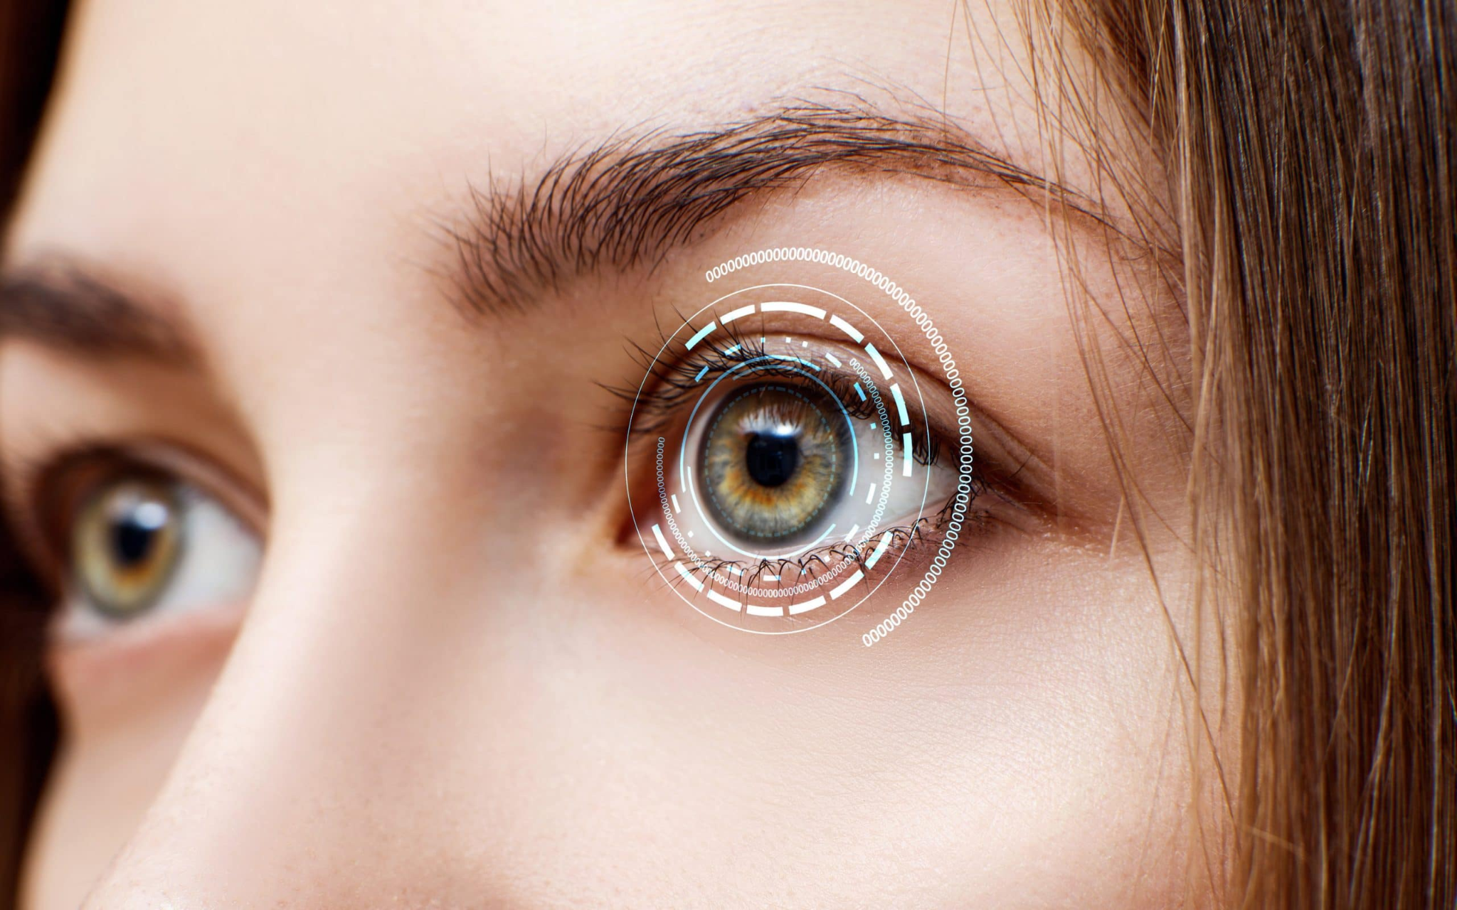
Iris and Eyeball Tracking

Slide 40
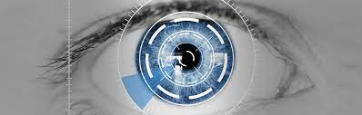
Definition
The process of measuring either the point of gaze (where one is looking) or the motion of an eye relative to the head. An eye tracker is a device for measuring eye positions and eye movement.

Slide 41



Packages Used
Some of the most popular mathematical functions are defined in the math module. These include trigonometric functions, representation functions, logarithmic functions, angle conversion functions, etc. In addition, two mathematical constants are also defined in this module.

Slide 42
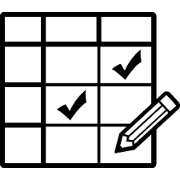
Helen Dataset
In our effort of building a facial feature localization algorithm that can work dependably and precisely under a wide scope of appearance variation, including pose,lighting, expression, occlusion, and individual contrasts, we understand that it is vital that the raining set include high resolution examples so that, at test time, a high resolution test image can be fit precisely.
Although a number of face databases exist,we discovered none that meet our necessities, especially the resolution requirement.Thus, they developed another dataset using annotated Flickr images.

Slide 43
Facial Point Annotations
The majority of existing databases provide annotations for a relatively small subset of the overall images.
The accuracy of provided annotations in some cases is not so good (probably due to human fatigue).
The annotation model of each database consists of a different number of landmarks.

Slide 44
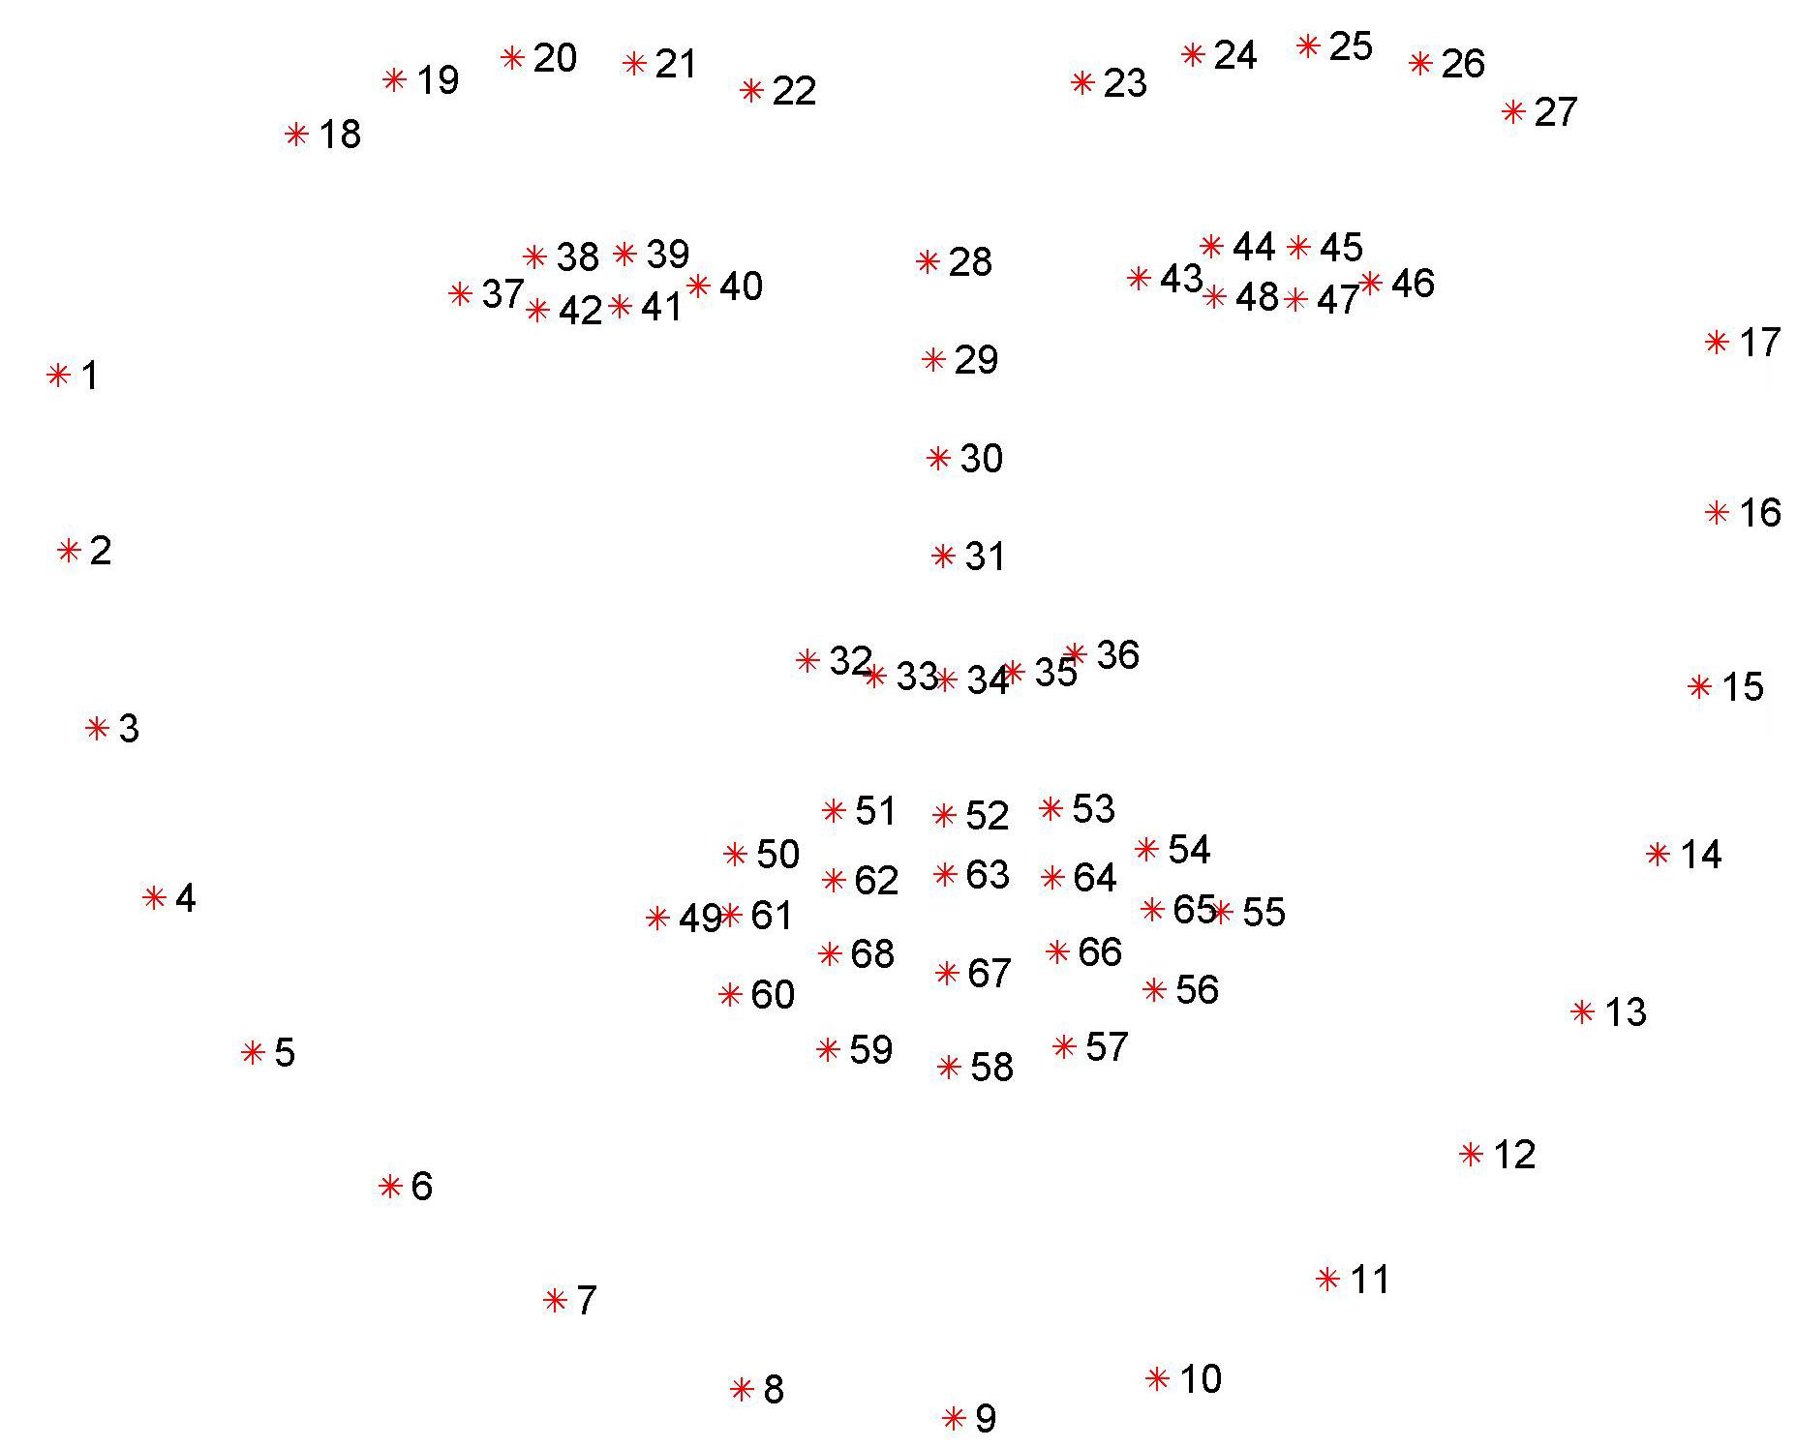
Facial Point Annotations

Slide 45
Advantages of Iris Tracking
More Accuracy compared to the alternatives. This also allows us to easily make a threshold for its x axis and y axis movement.
With iris, we can even calculate the time the subject is looking offscreen.
Also, Possibility of identifying if the person is having an aide within the screen as well, with window snapping.
Also, can flags users who take a quick glance offscreen.

Slide 46
Disadvantages of Iris Tracking
Less precision, due to the fact that most of the time iris is a very small part of the webcam feed. Unlike that of face, the fraction of iris within a frame is significantly less for iris.
Quiet taxing on the device it runs on. We figured out even the most efficient algorithms and classifiers required most of the resources of the device.
It requires a very stable and fast internet connection.
As of now Iris Tracking systems don't have an efficient algorithm for gaze estimation.
Requires a higher fault tolerance than its alternatives.

Slide 47
Video Demonstration

Slide 48



Tools Required
Python3
Jupyter Notebook
OpenCV (and/or Scikit-image)
Dlib (and/or Pillow)
NumPy and Pandas
Tensorflow (and/or Keras)
Scikit-Learn
Matplotlib

Slide 49
Thank you
One Drive Link:
https://amritavishwavidyapeetham-my.sharepoint.com/:f:/g/personal/cb_en_u4cse18310_cb_students_amrita_edu/EjaklIn5PLBOjkw3PNsN_TMBAQXT9FI1zu-FOotjkZv5LA?e=H6WqJe

